Slide 1

Agent Activity Chart
4/2/2023 11:17 PM
Print User : selenium.automation
Page 1 of 3

Slide 2
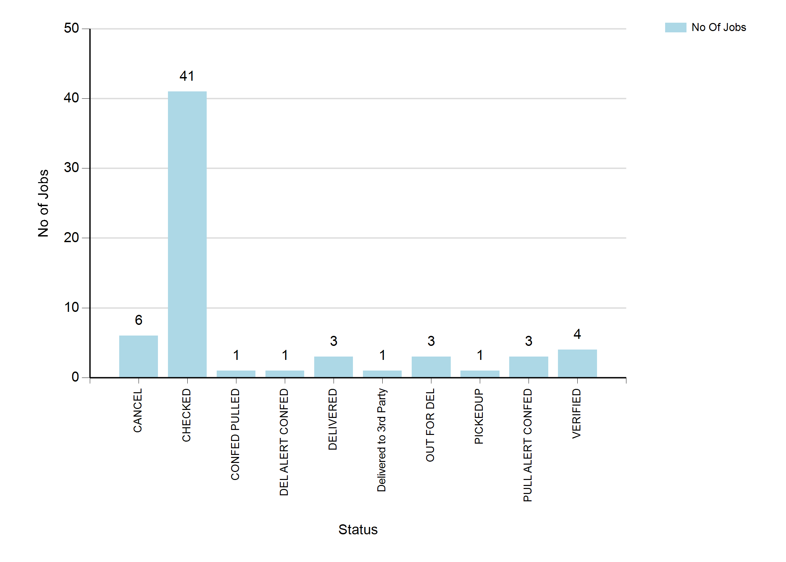
4/2/2023 11:17 PM
Print User : selenium.automation
Page 2 of 3

Slide 3
4/2/2023 11:17 PM
Print User : selenium.automation
Page 3 of 3

